Slide 1
The ability of chatGPT to generate code

Slide 2
Table of contents
01
02
03
04
Is ChatGPT the Ultimate Programming Assistant?
Refining ChatGPT-Generated Code: Characterizing and Mitigating Code Quality Issues
Is Your Code Generated by ChatGPT Really Correct?
A Comparative Study of Code Generation using ChatGPT 3.5 across 10 Programming Languages.
05
Extending the Frontier of ChatGPT: Code Generation and Debugging

Slide 3

01
Is ChatGPT the Ultimate Programming Assistant?

Slide 4
Idea
By contrasting it with Codex and CodeGen, the study assesses ChatGPT's performance in code generation, program repair, and code summarizing. It examines ChatGPT's advantages, disadvantages, and capacity for generalization on invisible issues.

Slide 5
Methodology and Datasets
utilizing two programming benchmarks: Refactory (for program repair and summarizing) and LeetCode (for code generation).
The LeetCode Benchmark (2016–2020 & 2022) is used to assess code generation for a variety of problem types, including hash tables, arrays, sorting, and strings.

Slide 6
Results
Code Generation: ChatGPT performs better than Codex and CodeGen, handling 95% of simple problems but having trouble with more complex, invisible ones.
Prompt engineering is essential; shorter prompts increase accuracy.
The success rate for program repair is 84%, which is comparable to that of the specialized Refectory tool. (90%).

Slide 7
Reflection
(+) Strengths: Assesses ChatGPT’s code generation, repair, and summarization vs. specialized models.
(-) Limitations: Doesn’t analyze real-world developer usability or security risks.
(+) Future research: Study ChatGPT’s role in professional coding & security vulnerabilities

Slide 8
02
Refining ChatGPT-Generated Code: Characterizing and Mitigating Code Quality Issues

Slide 9
Idea
This paper investigates the quality and dependability of code created by ChatGPT by methodically examining 4,066 Python and Java code snippets from 2,033 programming tasks.

Slide 10
Methodology and Datasets
2,033 programming LeetCode tasks (easy, medium, and hard) make up the dataset.
Correctness (generated code pass rates).
Problems with code quality (static analysis with Pylint, PMD, and Checkstyle tools).
Self-Repair Effectiveness (fix rate with prompts based on input).

Slide 11
Results
Code issues include 4% runtime errors, 47% maintainability issues, and 27% incorrect outputs.
Code generation accuracy ranges from 66% to 69%, however it falls by 5% on assignments after 2022.
Although iterative feedback increases accuracy, it can also result in new mistakes.

Slide 12
Reflection
(+)Strengths: Evaluates ChatGPT’s code quality, maintainability, and self-repair abilities.
(-) Limitations: Focuses only on Python & Java; lacks real-world complexity.
(+) Future research : Expand to more languages & integrate with real-world coding tools.

Slide 13
03
Is Your Code Generated by ChatGPT Really Correct?

Slide 14
Idea
By increasing test coverage, the study presents EvalPlus, a framework for thoroughly evaluating LLM-generated code. It reveals faults in LLMs that were previously unknown by extending the HUMANEVAL benchmark (used for evaluating LLM code synthesis) by 80× to create HUMANEVAL+.

Slide 15
Methodology and Datasets
Test-Case Generation: Generates a variety of test cases using mutation-based fuzzing and seed inputs supplied by ChatGPT.
Assesses 26 LLMs on HUMANEVAL+, an improved HUMANEVAL version with automated test creation (e.g., GPT-4, ChatGPT, CodeLlama).

Slide 16
Results
The accuracy of LLM decreases by as much as 28.9% when examined more thoroughly.
HUMANEVAL's ground-truth code contained 18 errors (11%) demonstrating the flaws in the current standards.

Slide 17
Reflection
(+) Strengths: Introduces EvalPlus, improving LLM code evaluation by fixing flawed benchmarks.
(-) Limitations: Benchmark-specific; increased test coverage raises execution costs.
(+) Future research : Expand EvalPlus to more languages & optimize test efficiency.

Slide 18
04
A Comparative Study of Code Generation using ChatGPT 3.5 across 10 Programming Languages

Slide 19
Idea
This study discusses the effectiveness of ChatGPT 3.5 code generating in 10 different programming languages. The study highlights ChatGPT strength and weakness in different tasks and language complexity in a pool pf 40 coding tasks.

Slide 20
Methodology and Datasets
Languages tested: C, C++, Go, JavaScript, Julia, Perl, Python, R, Ruby, and Smalltalk. Tasks used for evaluation: data science, games, security and simple algorithms.
A set of 40 predefined coding challenges of university level programming exercises were used across 4 fields: algorithms, games, data science and security.

Slide 21
Results
ChatGPT exhibits nondeterministic behavior in code generating.
ChatGPT struggles with low level languages compared to high level. ChatGPT is ethically inconsistent refusing to generate security related code in some languages while allowing it on others.

Slide 22
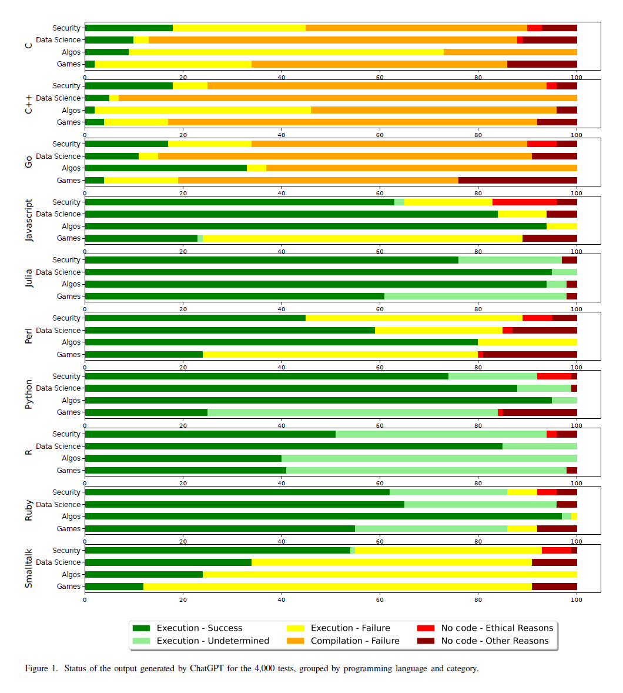

Slide 23
Reflection
Contributions: Sets an example of evaluating ChatGPT coding across 10 different coding languages, Highlights the strengths and weaknesses of LLM and raises concerns regarding security related code generating.
Potential for future research: More diverse LLM can be experimented on, more types of coding challenges can be experimented.

Slide 24
05
Extending the Frontier of ChatGPT: Code Generation and Debugging

Slide 25
Idea
This research examines ChatGPT 4 ability to solve programming challenges, focusing on both code generation and debugging skills.

Slide 26
Methodology and Datasets
128 problems were chosen from Leetcode covering: Array & String, DP, Divide & Conquer, Graph, Greedy, Hash Table, Math, Sorting, Tree, Two Pointers.
Each problem is given to ChatGPT, if the solution failed, feedback is given to ChatGPT asking for debugging and improving code.

Slide 27
Results
Over 128 problems, 71.875% were solved correctly. Out of the 128 problems 8 were fixed and 36 failed to solve.
90% success rate on easy problems and 55% on hard problems hence easy problems have well-structured problem-solving methods.

Slide 28
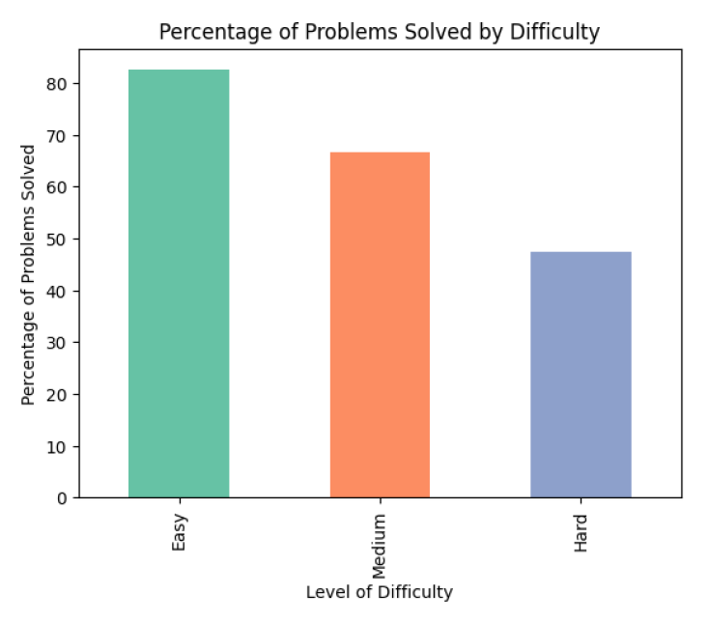

Slide 29
Reflection
Contributions: This study highlights ChatGPT weakness in debugging and dealing with more difficult coding challenges.
Limitations: Sample size is relatively limited. Potential for future research: More problems with bigger sample size can be further tested on.
More LLM can be tested on.

Slide 30
Thanks!

Slide 31
Resources
TIAN, CHEUNG, KLEIN, WEIQI LU, TSZ-ON LI, TANG, BISSYANDÉ. arXiv:2304.11938v2 [cs.SE] 31 Aug 2023 , Is ChatGPT the Ultimate Programming Assistant- How far is it?
LIU, LE-CONG, WIDYASARI, TANTITHAMTHAVORN, LI ,D. LE,LO. arXiv:2307.12596v2 [cs.SE] 15 Dec 2023, RefiningChatGPT-Generated Code: Characterizing and Mitigating Code Quality Issues.
Jiawei Liu, Chunqiu StevenXia , Yuyao Wang, Lingming Zhang. arXiv:2305.01210v3 [cs.SE] 30 Oct 2023, Is Your Code Generated by ChatGPT Really Correct? Rigorous Evaluation of Large Language Models for Code Generation.
Buscemi, A. (2023). A comparative study of code generation using chatgpt 3.5 across 10 programming languages. arXiv preprint arXiv:2308.04477.
Sakib, F. A., Khan, S. H., & Karim, A. R. (2024, July). Extending the frontier of chatgpt: Code generation and debugging. In 2024 International Conference on Electrical, Computer and Energy Technologies (ICECET (pp. 1-6). IEEE.

